Slide 1
Welcome
to
our
lesson!

Slide 2
Good morning children!

Slide 3
Tongue twister
There is a big black bed
In the big black bedroom.

Slide 4
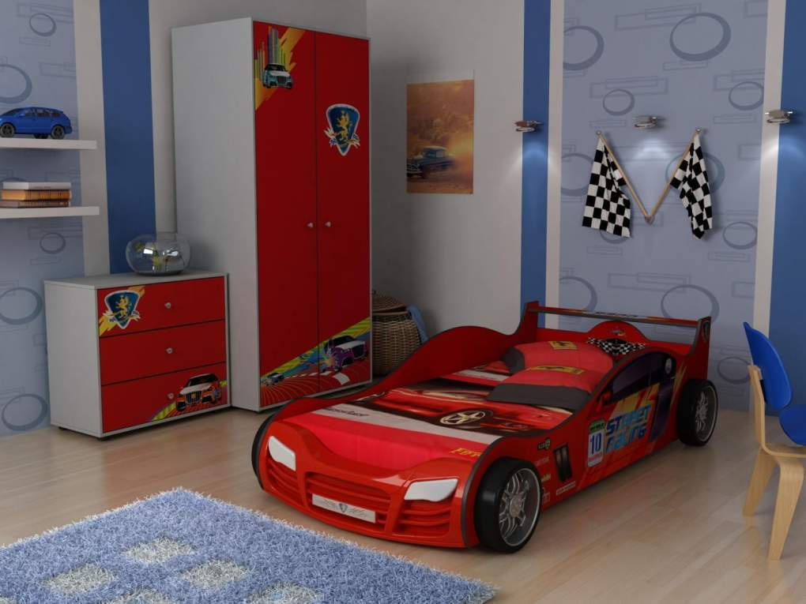
Tongue twister
Ted has a red bed.
On his bed Ted said:
“Red bed, red bed”.

Slide 5
Answer the questions:
Where do you eat?
Where do you sleep?
Where do you watch TV?
Where do you have a shower?
Where do you cook?

Slide 6
Theme: Rooms

Slide 7
Aims of the lesson:
•you will be able to learn vocabulary in a room
•make sentences there is / there are
•match and label the things
•pair work

Slide 8
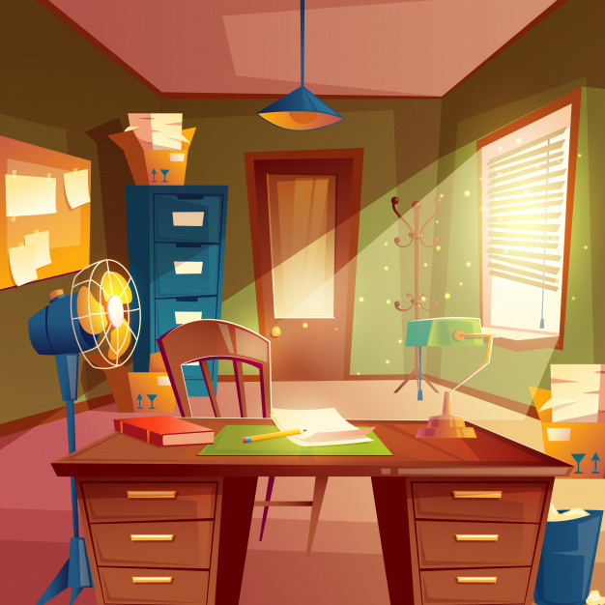
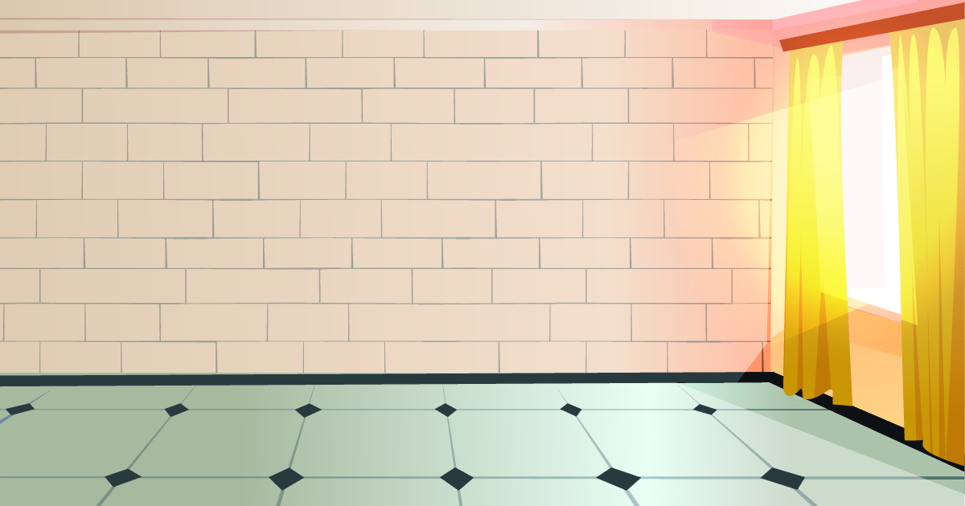
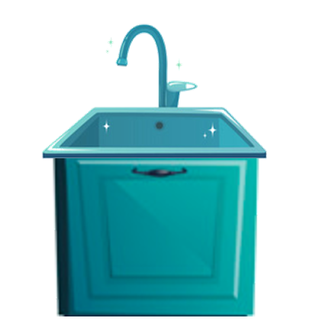
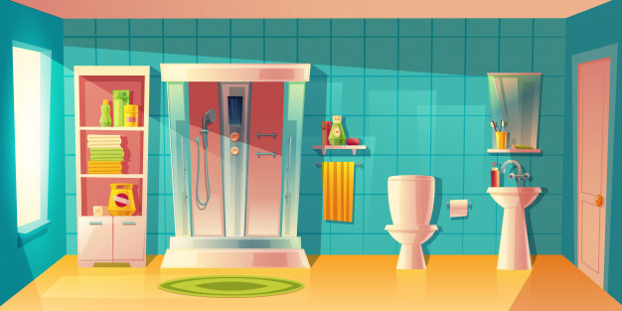
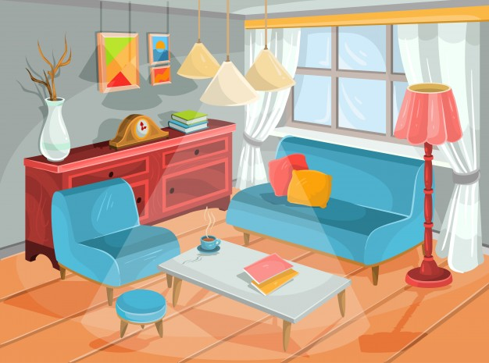
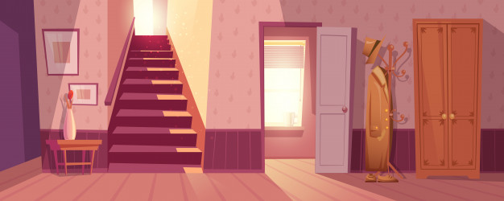
Parts of the house
dining room
study room
kitchen
bathroom
living room
hall

Slide 9
Rooms
Living room – a place where we rest, watch TV.
Bedroom – a place where we sleep.
Children’s room – the room for children.
Kitchen – a place where we cook.
Dining room – a place where we have meals.
Bathroom – a place where we wash ourselves, clean teeth, do the washing.

Slide 10
Vocabulary
Living room [liviη ru:m] – конок бөлмө
Kitchen [kit⌠in]- кухня
Dining room[dainiη ru:m] -ашкана
Bedroom [ bed ru:m]-уктоочу бөлмө
Bathroom [ba:θ ru:m]-ванная
toilet [tоilit]-даараткана

Slide 11
What is it ?
It is a bedroom.

Slide 12
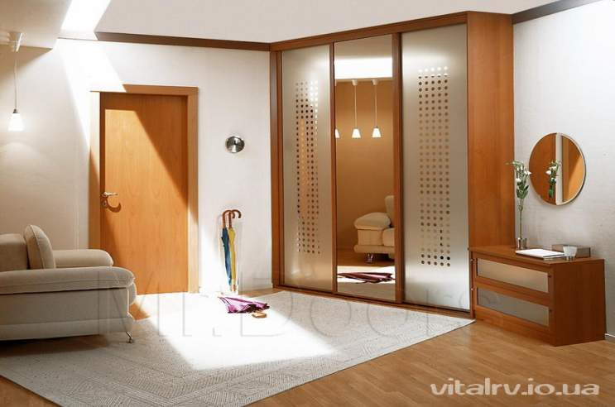
What is it ?
It is a hall.

Slide 13
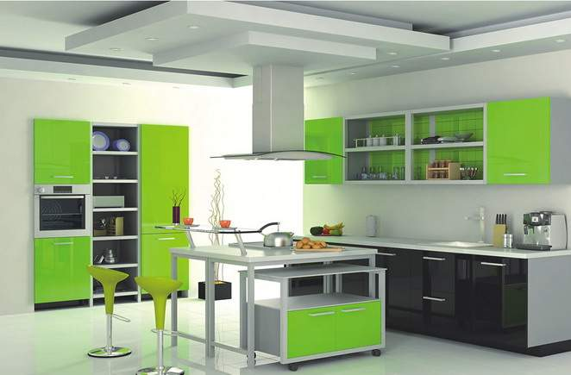
What is it ?
It is a kitchen.

Slide 14
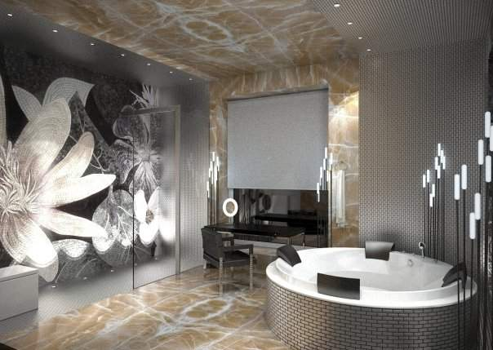
What is it ?
It is a bathroom.

Slide 15
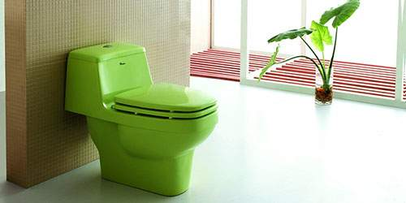
What is it ?
It is a toilet.

Slide 16
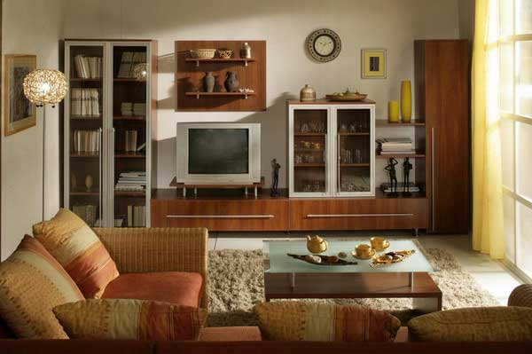
What is it ?
It is a living-room.

Slide 17
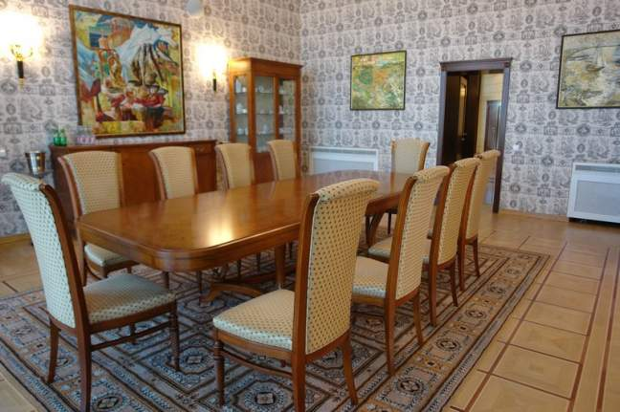
What is it ?
It is a dining-room.

Slide 18
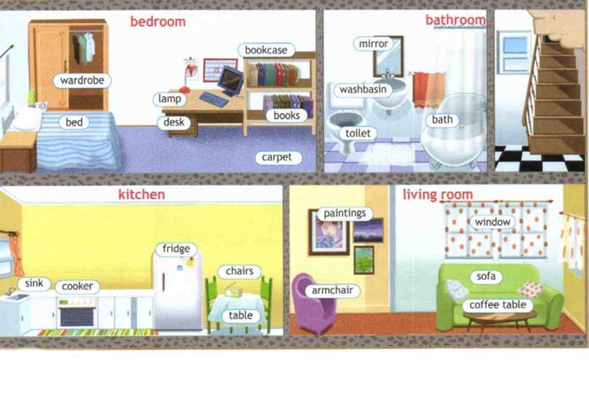
What are there in the rooms?

Slide 20
There is /are

Slide 21
Constructions
There is…
There isn’t …
There are…
There aren’t …
There is one window in the bedroom.
There isn’t a lamp on the desk.
There are two chairs in the kitchen.
There aren’t tables in the hall.

Slide 22
There is/there are
1. There …. Four rooms in our flat.
2. There …. no TV in my bedroom.
3. … there any paintings in the living room?
4. There … a fridge, a cooker and a sink in the kitchen.
5. … there any books in the bookcase?
6. There …. no carpet in the kitchen.
are
is
Are
is
Are
is

Slide 26
Thank you!

